Slide 1
Employment – Then, Now, and Beyond
Pennsylvania Office of Developmental Programs (ODP)

Slide 2
Workforce Innovation and Opportunity Act
Signed by President Barack Obama on July 22, 2014
“WIOA is designed to help job seekers access employment, education, training and support services to succeed in the labor market and match employers with the skilled workers they need to compete in the global economy.”
https://www.doleta.gov/wioa/Overview.cfm
Notes:
The Workforce Innovation and Opportunity Act is designed to help job seekers access employment, education, training and support services to succeed in the labor market and match employers with the skilled workers they need to compete in the global economy. The main impact of this act on ODP employment services is in regard to Section 511 of the Rehabilitation Act, as added by WIOA. Section 511 provides limitations on the use of Section 14(c) subminimum wage certificates
for youth transitioning from secondary education and limitations on schools regarding contracts with Section 14(c) certificate holder. The intent of Section 511, and WIOA more broadly, is to insure that transition from secondary education and/or postsecondary education to competitive integrated employment is the primary goal for youth in transition, including youth with significant disabilities. Section 511 of the Rehabilitation Act, as added by the Workforce Innovation and Opportunity
Act (WIOA), makes several changes to Section 14(c) of the FLSA including:
Prohibits anyone age 24 or younger from starting work at subminimum wage unless it is documented that the person received transition services under the Individuals with Disabilities Education Act (IDEA); has applied for VR services and was unsuccessful; and has been provided counseling and referral to other resources with the goal of CIE.

Slide 3
Executive Order 2016-03
Executive Order: 2016-03 – Establishing “Employment First” Policy and Increasing Competitive Integrated Employment for Pennsylvanians with a Disability
Establishes policy for agencies under the Governor’s jurisdiction, requiring competitive-integrated employment be the first consideration and preferred outcome of all publicly-funded education, employment and training, and long-term supports and service programs for working-age Pennsylvanians with a disability.
The Executive Order also prompts us to work closer together and more effectively as agencies DHS, OVR, and PDE) to help people obtain jobs in the community.
DHS – Department of Human Services
OVR – Office of Vocational Rehabilitation
PDE – Pennsylvania Department of Education
Notes:
Kelly
First Say - On March 10, 2016, Governor Tom Wolf signed Executive Order 2016-03, entitled “Establishing ‘Employment First’ Policy and Increasing Competitive-Integrated Employment for Pennsylvanians with a Disability.”
Before we get into the Executive Order, I’d like to read a few statistics that are noted in the Executive Order Recommendations Summary, which I’ll talk about shortly.
RELEVANT STATISTICS FOR PENNSYLVANIA
According to the U.S. Census Bureau, 19 percent of the population has a disability. About 66 percent of the population is working age (typically defined as ages 16-64), which means in Pennsylvania there are approximately 1.6 million working-age people with a disability.
The U.S. Bureau of Labor Statistics reports that only 20 percent of people with a disability participate in the labor force, meaning they are either employed or unemployed but looking for work, compared to a 63 percent labor participation rate for all people.
In Pennsylvania, more than 105,000 students with a disability ages 14- 21 (transition age).
These statistics make it all the more important that PA is an Employment First State.
Then, Read Slide.
So what does all of this mean? This means that employment should be at the forefront of conversations that we as agencies have with individuals we serve and that we are giving them every opportunity to pursue a job in the community.

Slide 4
Act 36 of 2018 - Employment First Act
Employment First Act, signed June 19, 2018
Governor's Cabinet for People with Disabilities
Employment First Oversight Commission
Notes:
The overall intent of the Act is that it establishes that competitive integrated employment is the first consideration and preferred outcome of publicly funded education, training, employment and related services, and long-term services and support for individuals with a disability.

Slide 5
Governor's Cabinet for People with Disabilities
Act 36 of 2018 - Employment First Act
Develop recommendations for changes in regulations, policies, and procedures to ensure implementation of Employment First
Develop recommendations for the consistent collection of data and sharing of data
A three-year plan is under development
Notes:
The Governor appoints the Cabinet and it’s composed of Secretaries of Departments and others defined in the law
The Cabinet is tasked with the review of existing regulations, policies, etc. related to the goal of competitive integrated employment for individuals with a disability
They can also make recommendations to the Governor for legislative changes necessary to support and implement the Employment First Act.
The Initial plan – the Governor’s office is supposed to submit the initial plan to the general assembly by August 19, 2019. The plan should identify specific policies and implementation dates for the state agencies to comply with the Employment first Act.

Slide 6
Employment First Oversight Commission
Act 36 of 2018 - Employment First Act
Establish measurable goals and objectives for state agencies
Track progress of state agencies in implementation of the Employment First Act
Issue an annual report that includes:
The progress made on the goals and objectives
Recommendations to the Governor and General Assembly on strategies and policies needed to support the implementation of the Employment First Act
Notes:
Independent commission of people that are not employees of the Commonwealth
The commission must consist of at least 51% of people who have disabilities
Annual report due October 1 of each year
ODP has been working closely with the Commission to provide them aggregate data that they have requested

Slide 7
Everyday Lives – Values in Action
“Everyday Lives affirms our dedication to making it possible for everyone to live a life of meaning and joy.”
Nancy Thaler, former Deputy Secretary of the Office of Developmental Programs

Slide 8
Everyday Lives Recommendations

Slide 9
Values in Action : My Life, My Way
VALUES STATEMENTS
WHAT IS IMPORTANT TO PEOPLE WITH DISABILITIES?
EVERYDAY LIVES IN ACTION: My Life, My Way
Employment/meaningful contribution: I want to work and/or have other ways to contribute to my community. My family, supporters, and community support me to find and keep a real job that I like with good wages and benefits or start and run my own business, and/or volunteer the way I want in my community.

Slide 10
Values in Action: Recommendations

Slide 11
Strategies to Increase Employment
Inform families about employment opportunities when their children are young; inform self-advocates as they approach the age of transition.
Build an Employment First assumption in all supports coordination planning activities, including the ISP redesign and training.
Provide training and ongoing technical assistance to service providers and supports coordinators.
Establish a baseline number of people receiving employment services and those employed; routinely publish data on work and wages.

Slide 12
Strategies to Increase Employment
Connect OVR Workforce Development information system and ODP information system (HCSIS) to enable the departments to share information.
Support provider transformation to employment services.
Facilitate public-private partnerships and local interagency coalitions to support employment opportunities and encourage innovation.
Add benefits counseling to inform individuals, self-advocates, and families about options to work without losing benefits including the ABLE Act and Medicaid buy-in.

Slide 13
Strategies to Increase Employment
Promote and increase government hiring of people with disabilities.
Offer P/FDS waiver services to high school seniors interested in work and who transition into competitive, integrated jobs.
Support the growth and advancement of post-secondary education programs.
Create service definitions and rates to incentivize providers and support individuals, self-advocates, and families.

Slide 14
Accomplishments
Data Enhancements:
The Office of Vocational Rehabilitation (OVR) and ODP Data Sharing Agreement/Memorandum was approved in December 2017.
ODP’s Employment Dashboard was created to capture valuable information for further analysis and sharing.
ODP Comprehensive Employment Report for Calendar Year 2017 was released in ODP Communication 096-18. Second annual comprehensive employment report is in development.

Slide 15
Calendar Year 2017 – Employment Report
Issued October 26,2018

Slide 16
ID/A Waiver and Adult Autism Waiver Employment Services

Slide 17
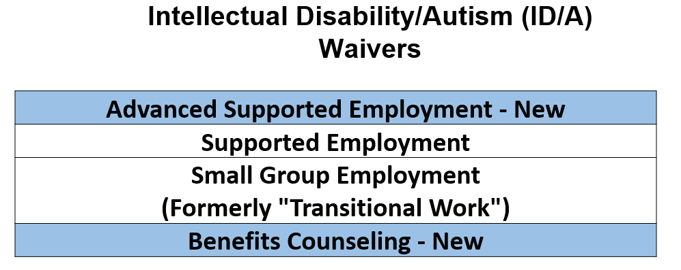
Employment Services: ID/A Waivers
ID/A Waivers - Consolidated Waiver, Person/Family Directed Support Waiver, and Community Living Waiver

Slide 18
What do the Services Include?
 | Advanced Supported Employment | Supported Employment | Small Group Employment | Benefits Counseling
What is covered in this service? | Advanced Supported Employment - Discovery Profile Advanced Supported Employment - Securing a Job Advanced Supported Employment - Retention of Job | Career Assessment Job Finding/Development Job Coaching and Support | Small group employment services include mobile work force, work station in industry, affirmative industry, and enclave. Supports for the participant to work alongside others to gain the skills and knowledge in the transition to competitive integrated employment Transportation if it is an integral component of the service – to the worksite. | Inform and educate participants on the impact of employment on publicly funded and SSA benefits. Inform participant on SSA work incentives Inform participant on income reporting requirements for SSA and public benefit programs

Slide 19
On-The-Job Companion Support
 | Advanced Supported Employment | Supported Employment | Small Group Employment
On-the-Job Companion Support | Companion services may be provided at the same time as these services to support the individual with personal care needs. | Companion services may be provided at the same time as these services to support the individual with personal care needs. | Support with personal care needs is included as part of the Small Group Employment service. Companion services may not be authorized for this.

Slide 20
Community Participation Supports

Slide 21
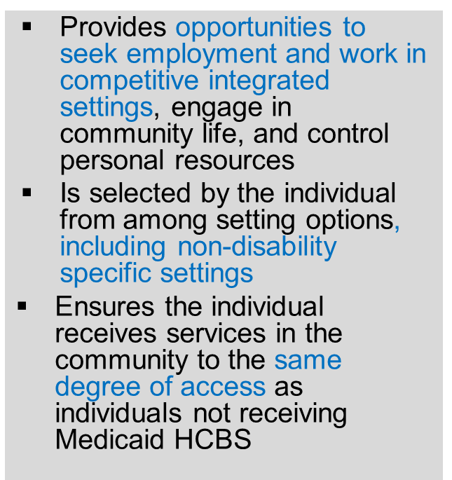
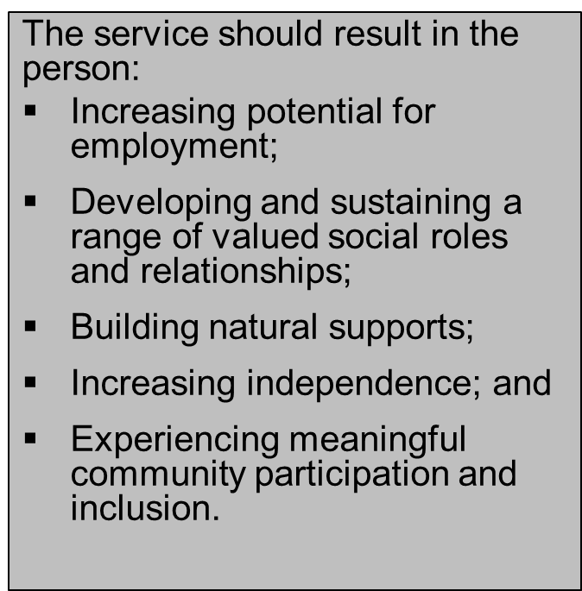
What does this Service Include?
Community Participation Supports
HCBS Settings Rule

Slide 22
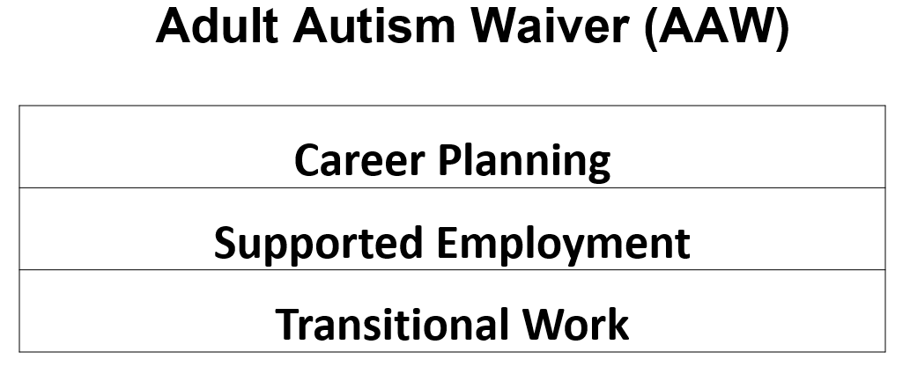
Employment Services: Adult Autism Waiver

Slide 23
What do the services include?
 | Career Planning | Supported Employment | Transitional Work Services
What is covered in this service? | Vocational Assessment: discovery, community-based job try-outs or situational vocational assessments; development of a vocational profile Job Finding: Prospective employer relationship-building/networking, Identifying potential employment opportunities based on the person’s vocational profile | Intensive Job Coaching: Onsite job training and skills assessment, development of natural supports in the work place, coordinating with employers, co-workers (including developing co-worker supports,) and customers Extended Employment Supports: Reminders of effective workplace practices, enforcement of skills gained prior to employment or during the period of Intensive Job Coaching | Transitional Work Services include mobile work force, work station in industry, affirmative industry, and enclave. Supports for the participant to work alongside others to gain the skills and knowledge in the transition to competitive integrated employment Transportation if it is an integral component of the service – to the worksite.

Slide 24
Accomplishments
Increase in people with Competitive Integrated Employment (CIE) – 2% Increase in the percentage of ODP-enrolled individuals who are competitively employed – 13% in July 2017, 15% in August 2018. (Source: HCSIS, Employment page)
*The percentage of people who are enrolled with ODP and are competitively employed has risen to 16% in June of 2019 (the most recent month displayed on the ODP employment dashboard.)

Slide 25
Then and Now - Statewide
From July 2017-June 2019, the percentage of people enrolled with ODP, statewide, who are also competitively employed has increased by 3%.
July 2017 – 13%, June 2019 – 16%

Slide 26
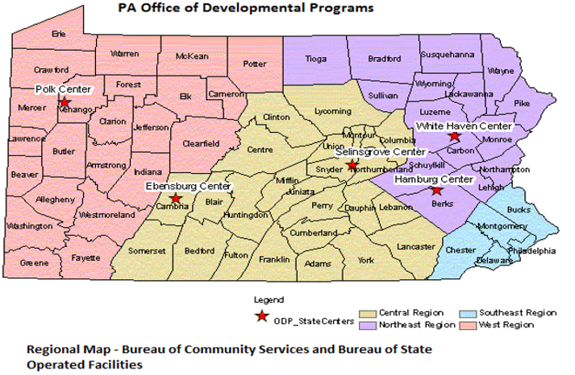
ODP Regional Structure – Bureau of Community Services
*Please Note: Hamburg Center closed in August 2018.

Slide 27
Then and Now – Northeast Region
From July 2017-June 2019, the percentage of people enrolled with ODP in the Northeast Region who are also competitively employed has increased by 2%.
July 2017 – 10%, June 2019 – 12%

Slide 28
Then and Now – Southeast Region
From July 2017-June 2019, the percentage of people enrolled with ODP in the Southeast Region who are also competitively employed has increased by 3%.
July 2017 – 14%, June 2019 – 17%

Slide 29
Then and Now – Western Region
From July 2017-June 2019, the percentage of people enrolled with ODP in the Western Region who are also competitively employed has increased by 3%.
July 2017 – 12%, June 2019 – 15%

Slide 30
Then and Now – Central Region
From July 2017-June 2019, the percentage of people enrolled with ODP in Central region has increased by 5% from July 2017-June 2019.
July 2017 – 13%, June 2019 – 17%

Slide 31
Dauphin, Cumberland, and Perry Counties
From July 2017-June 2019, the percentage of people enrolled with ODP in Dauphin, Cumberland, and Perry Counties who are also competitively employed has increased by 9% (July 2017 – 14%, June 2019 – 23%)

Slide 32
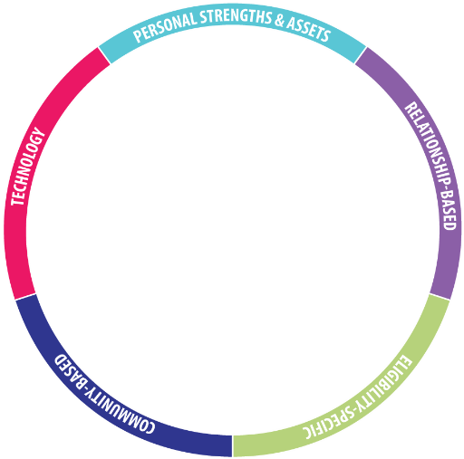
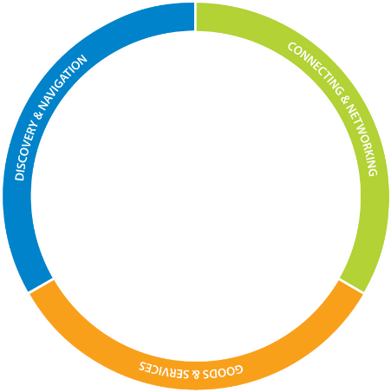
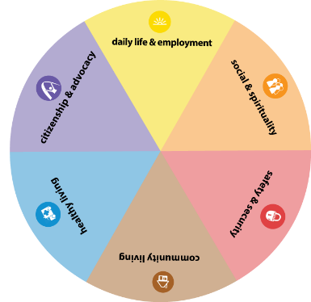
The Life Course Framework

Slide 33
2018 Pennsylvania Community on Transition Webinar Series
Notes:
Good Afternoon, my name is ________________________. This webinar is being brought to you by The Pennsylvania Community on Transition and on behalf of the PA-Community on Transition, I want to thank you for joining us today.
The Pennsylvania Community on Transition is a group of various stakeholders from across Pennsylvania who work collaboratively to ensure appropriate transition outcomes for Pennsylvania youth and young adults.
The Pennsylvania Community on Transition is a state leadership team consisting of representative from: the State Departments of Education, Health, Labor and Industry, and Human Services; Various Serving Agencies, Young Adults, Parent Organizations, Advocates, Higher Education, and Employers.
The shared vision and common goals of the Pennsylvania Community on Transition is achieved when all PA youth and young adults with disabilities:
- Successfully transition to the role of productive and participating adult citizens
- Are empowered to recognize their talents, strengths, and voice
Have equal access to resources that will promote their full participation in the communities of their choice.
This webinar series is designed to assist individuals of all abilities think about life experiences needed to move ahead in life. Throughout the series, a cross-agency panel, including the Office of Vocational Rehabilitation (OVR), Office of Developmental Programs (ODP), and Pennsylvania Youth Leadership Network (PYLN) representatives will provide participants with information on what IEP teams and students need to know and do regarding setting a vision for a meaningful life, identify how to find or develop supports, and discover what it takes for students to live the lives they want to live.
Charting the LifeCourse™ and LifeCourseTools.com is a project of the University of Missouri-Kansas City Institute for Human Development, Missouri’s University Center for Excellence in Developmental Disabilities Education, Research and Services (UCEDD) and endorsed by the Pennsylvania Department of Health and Human Services and supported by the Pennsylvania Community on Transition.
This series is Part three of four.
December 5, 2018 Planning for the LifeCourse - Employment Uses
February 6, 2019 Planning for the LifeCourse - Postsecondary Education and Training Uses
April 1, 2019 Planning for the LifeCourse - Independent Living
For those of you on the webinar, I want to remind you that we are using Zoom Webinar for today’s presentation. This webinar is being recorded and will be archived on the PaTTAN website. Zoom has a chat feature that can be used to ask questions directly to the panel. This will be monitored by staff. In addition, there is a Q/A feature. All participants will be muted for the webinar so please use those features is you have a question. ACT 48 and CRC are NOT being offered for today. If you are need of a certificate of participation, please email me at XX.
In addition to myself, today’s panel includes:
Everett Diebler representing Pennsylvania Youth Leadership Network.
Kim Robinson Division Chief, Transition and 511
Pennsylvania Department of Labor & Industry
Kelly J. B. Arnold | Human Services Program Specialist | Employment Director
Pennsylvania Department of Human Services | Office of Developmental Programs
Amy Millar | Supporting Families Statewide Initiative Coordinator
Pennsylvania Department of Human Services | Office of Developmental Programs
At this time, I am going to turn presentation over to Amy Millar of ODP.

Slide 34
The Life Course Principals
34
Notes:
As you may recall from the October webinar overview of the Charting the LifeCourse framework rand tools, the core belief of the LifeCourse Framework is that all people have the right to live, love, work, play, and pursue their life aspirations in their community.
What you see here are the building blocks of the Charting the LifeCourse Framework. They are the core principles and values that are important as we begin to think differently about what it means to support individuals with disabilities and their families to have good lives.

Slide 35
Everyday Life Domains
Daily Life and Employment
(school/education, employment, volunteering, routines, life skills)
Healthy Living
(medical, behavioral, nutrition, wellness, affordable care)
Safety and Security
(emergencies, well-being, legal rights & issues, guardianship options & alternatives )
Community Living
(housing, living options, home adaptations and modifications, community access, transportation)
Citizenship and Advocacy
(valued roles, making choices, setting goals, responsibility, leadership, peer support)
Social and Spirituality
(friends, relationships, leisure activities, personal networks, faith community)
Notes:
These are the life domains that everyone, including families of and people with disabilities, experience.
Life domains are different aspects of life that we all consider as we age and grow.
Everyone has to figure out what they’ll do during the day – got to school, volunteer, get a job, where they live, how they’ll stay healthy, etc.
Thinking about daily life and employment, which is the focus of today’s webinar, we think about the life stages in which a family member and the child’s support system focuses on in relation to this domain. During the early years, the focus is getting a child ready for school. During the school years, the focus begins to turn to getting ready for adult life – working toward a vision of what the person will do after school ends, what kind of job they might have, and what their day-to-day life might look like. Amy referenced this in October, but I wanted to mention again the “Charting the LifeCourse Experiences and Questions Booklet – A Guide for Individuals, Families and Professionals,” otherwise known as the blue book. This booklet is a guide for the aforementioned audiences that contains questions to consider related to each life domain, during each life stage, which are prenatal and infancy, early childhood, school age, transition, adulthood, and aging.
Highlight Employment Guide (to be released in spring)

Slide 36
The importance of having a vision of a good life
Having a vision sets the dream, the positive expectation for the future.
But without a vision, there is no expectation of what the future might look like.

Slide 37
The most powerful force in changing transition outcomes for young people with significant disabilities is not ultimately found in the transition plans we craft, the educational services we offer, the instruction we provide, or the systems we build, but rather in the expectations and aspirations individual parents hold for their sons and daughters. All of these other efforts are no doubt essential, but absent families equipped with a clear and compelling vision for a “good life” after high school, we are missing something utterly essential.
- Erik Carter
“What Matters Most: Research on Elevating Parent Expectations”
Link: www.supportstofamilies.org/wp-content/uploads/parent-expectations_D21.pdf
Notes:
“There is a tension here we must release. Professionals are sometimes reluctant to encourage parents to “hope large” because it ultimately will require us to do things differently, demand us to invest differently. We must be willing to let families show us what is possible when their vision exceeds our own. Indeed this is how the world has always moved forward fastest. “ ~ Erik Carter
Expectations are formed early and over time and they are influenced by opportunities and supports.
Having expectations for the future encourages us to shape experiences day to day, and to allow those experiences to shape new expectations and discoveries.
www.supportstofamilies.org/wp-content/uploads/parent-expectations_D21.pdf

Slide 38
How Can the LifeCourse Framework Help with Employment?
LifeCourse can help us understand all the many benefits of working, beyond making money.
LifeCourse can help us have high expectations and envision the kind of work that will be fulfilling and where we can make a difference.
LifeCourse focuses on the day-to-day experiences, relationships, supports, and resources that will keep us moving toward our vision.

Slide 39
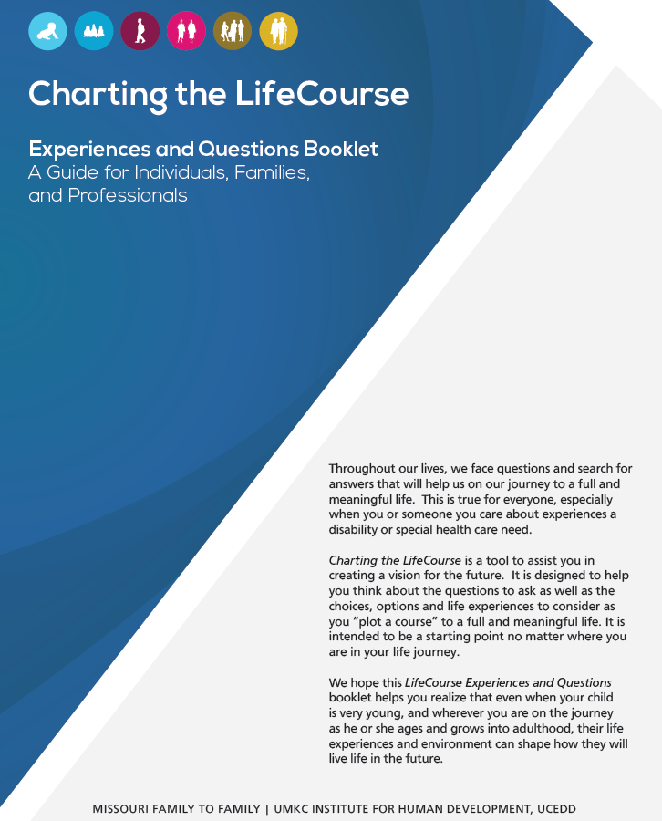
The “Blue Book”- Great Resource
https://www.lifecoursetools.com/planning/
Notes:
Here’s a picture of the “blue book” that I’ve referenced throughout this slide deck. It is available for download following the link on the screen, and is a terrific resource for schools.

Slide 40
Questions to Consider
Notes:
Kelly
Remember how I mentioned earlier about an employment guide that is coming out? Well, these are some examples of questions that said guide will address. However, there is an employment section within the blue book that focuses on employment, and these screenshots are taken directly from it. No matter what age of students you teach, or where a family may be in their child/student’s life stage, this booklet can serve as a helpful guide in considering what questions to ask of oneself and their loved one in envisioning employment aspirations.
Read one question from each life stage.

Slide 41
Questions to Consider
Notes:
Kelly
Here are more questions related to the life stages of transition, adulthood, and aging.
You can see the connection between the questions under the transition column, for instance, and the exercise we just reviewed related to Izzy. Her trajectory and integrated supports and services star can help her support system address the question of what supports she can utilize to get work or volunteer experience, what social and academic skills she can capitalize on in relation to her interests, as well as understanding the different roles that friends, family, and other community members can play in helping Izzy achieve her dream of working in the beautify/art field.

Slide 42
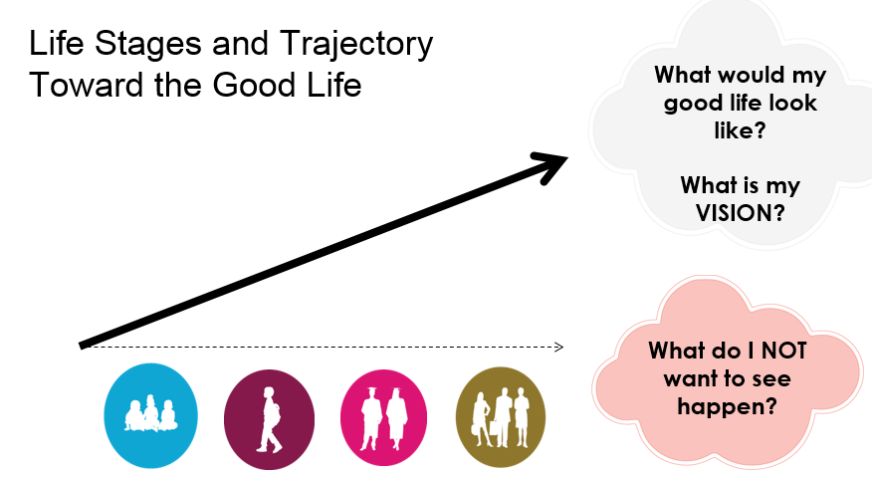
Trajectory – What is Your Vision?
Notes:
Aim for a target, a clear picture of what a good life would look like for people.
What happens to us early in our lives has a significant impact on our quality of life and well-being in the future. It is important to help people have positive, healthy experiences, adequate support, and ample opportunities to learn and make mistakes so that they can have better outcomes later in life.
Sometimes people can’t see what a good life would look like, but can see what they don’t want. It’s ok to start with identifying what they don’t want.
And sometimes the trajectory isn’t straight, but we can get back on track!

Slide 43
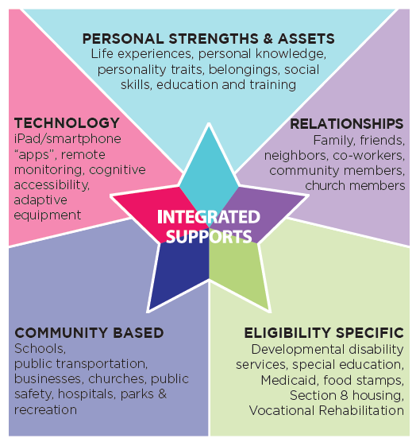
Integrated Services and Supports for a Good Life

Slide 44
Integrated Services and Supports Star

Slide 45
What is on the Horizon?

Slide 46
Moving Forward
Continued and strengthened collaboration among statewide, regional, and local entities (professional, self-advocates and families, businesses)
Continued training and networking opportunities for professionals
Publication of a PA Employment Guide
Publication of the next comprehensive employment report
ID/A Waiver Amendments (circa fall 2019)
Local-level employment coalition activities
Re-visited ISAC Recommendations

Slide 47
PA LifeCourse Employment Guide

Slide 48
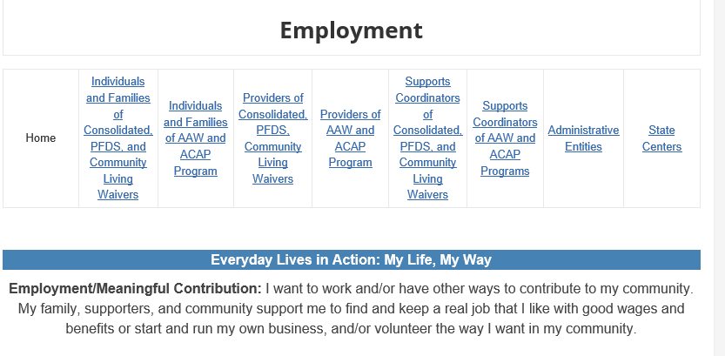
MyODP Employment Page
Path – www.myodp.org → Home → Resources → Employment

Slide 49
Everyday Lives 2020

Slide 50
Thank you!
Kelly Arnold – ODP Central Region Employment Lead – kelarnold@pa.gov

